Slide 1
Advanced Topics
Fundamentals of Curve generation and Color models

Slide 2
Fundamentals of curve generation
Introduction:
Objects in the real world may not always be made up of regular geometric shapes.Surfaces are made up of curved surfaces & curved edges.
Curves are quite complicated to represent them in exact mathematical equations.Curves are classified into two categories- namable, unnamable.Namable curves known as true-curve generation approach(planes, spheres, parabolas, circles, straight lines)

Slide 3
Types of Curves
Implicit Curves
Implicit curve representations define the set of points on a curve by employing a procedure that can test to see if a point in on the curve. Usually, an implicit curve is defined by an implicit function of the form −
F(x,y)=0
Explicit Curves
can be plotted as a curve. Such a function is the explicit representation of the curve. The explicit representation is not general, since it cannot represent vertical lines and is also single-valued. For each value of x, only a single value of y is normally computed by the function.
y=f(x)

Slide 4
Parametric Curves
Curves having parametric form are called parametric curves. The explicit and implicit curve representations can be used only when the function is known. In practice the parametric curves are used. A two-dimensional parametric curve has the following form −
P(t)=f(t),g(t)

Slide 5
Curve continuity
To guarantee a smooth transition from one section of the piecewise curve to the next, we can enforce continuity conditions at the link points. There are two types of curve continuities: geometric & parametric.
In geometric continuity, requires parametric derivatives of two curve sections to be proportional to each other at their common boundary instead of equal to each other.Parametric continuity is obtained by matching the parametric derivatives of the adjoining two curve segments at their common boundary.

Slide 6
Conic curve
Curves are one of the most important primitive shapes to create high resolution graphics. While using many small polylines allows to create graphic that appears smooth at fixed resolution and they do not preserve smoothness when scaled.
Curves can be stored much easier, can be scaled to any resolution without loosing smoothness and provide much easier way to specify real world objects. A conic section or just conic is a plane curve that can be formed by intersecting a cone with a plane that does not go through the vertex of the cone.
Five types of conics are: Circle, Hyperbola, Parabola, Rectangular Hyperbola and Ellipse.
A circle and an ellipse are created when a cone and plane are intersected as a closed curve.

Slide 7
Spline curve representation
A spline is used to refer to a wide class of functions that are used in applications requiring data interpolation & smoothing.
These type of curves in the field of computer science because of the simplicity of their construction, accuracy of evaluation & their capacity to approximate complex shapes through curve fitting & interactive curve design.
It produces smooth curves through a designated set of points using piecewise cubic polynomial functions. Two categories comes under this,

Slide 8


Interpolation - the curve passes through
all of the control points.
Approximation - the curve does not pass through all of the control points

Slide 9
Bezier curve
Bezier curves must have precisely n control points, where n+1 is the degree of the Bezier polynomial.
By connecting bezier curves we can create long curves.This is done by connecting last control point of one curve the same as first control point of next curve.
This type of curve always lie within the convex hull of the control points & always have the sum of the basis functions add to 1.
A convex hull of set of points is the smallest convex polygon that contains one of the points.

Slide 10
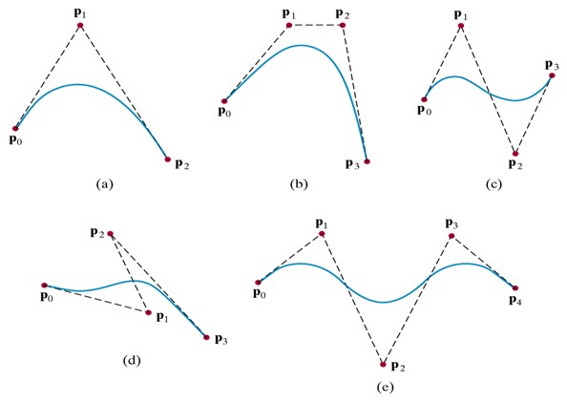

Slide 11
Bezier Curve Properties
Few important properties of a bezier curve are:
1. Bezier curve is always contained within a polygon called as convex hull of its control points.
2. Bezier curve generally follows the shape of its defining polygon.
The first and last points of the curve are coincident with the first and last points of the defining polygon.
3. The degree of the polynomial defining the curve segment is one less than the total number of control points.
Degree = Number of Control Points – 1

Slide 12
4. The order of the polynomial defining the curve segment is equal to the total number of control points.
Order = Number of Control Points
5. Bezier curve exhibits the variation diminishing property.
It means the curve do not oscillate about any straight line more often than the defining polygon.

Slide 13
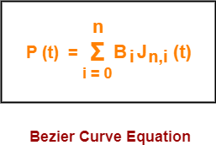
A bezier curve is parametrically represented by-
Equation:
Here,
t is any parameter where 0 <= t <= 1
P(t) = Any point lying on the bezier curve
B_{i} = i^{th} control point of the bezier curve
n = degree of the curve
J_{n,i}(t) = Blending function = C(n,i)t^{i}(1-t)^{n-i} where C(n,i) = n! / i!(n-i)!

Slide 14
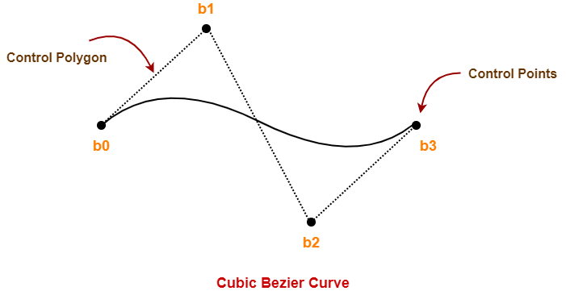
Cubic Bezier Curve-
Cubic bezier curve is a bezier curve with degree 3.
The total number of control points in a cubic bezier curve is 4.

Slide 15
Here,
This curve is defined by 4 control points b₀, b₁, b₂ and b₃.
The degree of this curve is 3.
So, it is a cubic bezier curve.
By this using the equation and Substituting n = 3 for a cubic bezier curve, we get-

Slide 16

We get,
Expanding the above equation, we get-
P (t) = B₀J_{3,0}(t) + B₁J_{3,1}(t) + B₂J_{3,2}(t) + B₃J_{3,3}(t) ………..(1)

Slide 17
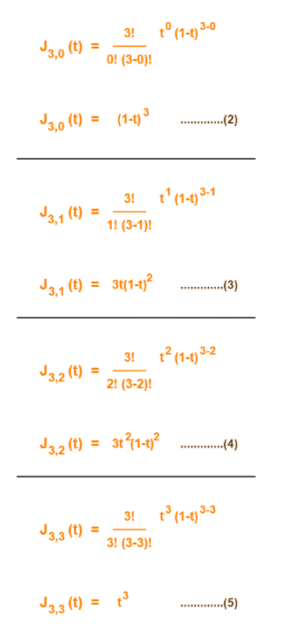

Slide 18
Using (2), (3), (4) and (5) in (1), we get-
P(t) = B₀(1-t)³ + B₁3t(1-t)² + B₂3t²(1-t) + B₃t³
This is the required parametric equation for a cubic bezier curve.

Slide 19
Applications of Bezier Curves-
Computer graphics
Animation
Fonts

Slide 20
B-spline curves:
A spline curve is a sequence of curve segments that are connected together to form a single continuous curve.It refers to a spline curve parameterized by spline functions that are expressed as linear combinations of splines.
A B-spline is simply a generalization of a bezier curve.
fractal curves:
A fractal is defined as a rough or fragmented geometric shape that can be split into parts, each of which is approx. a reduced-size reproduction of the complete shape, based on the property known as self similarity.
Many natural objects that approximate fractals to a degree, include clouds, mountains, coastlines.

Slide 21
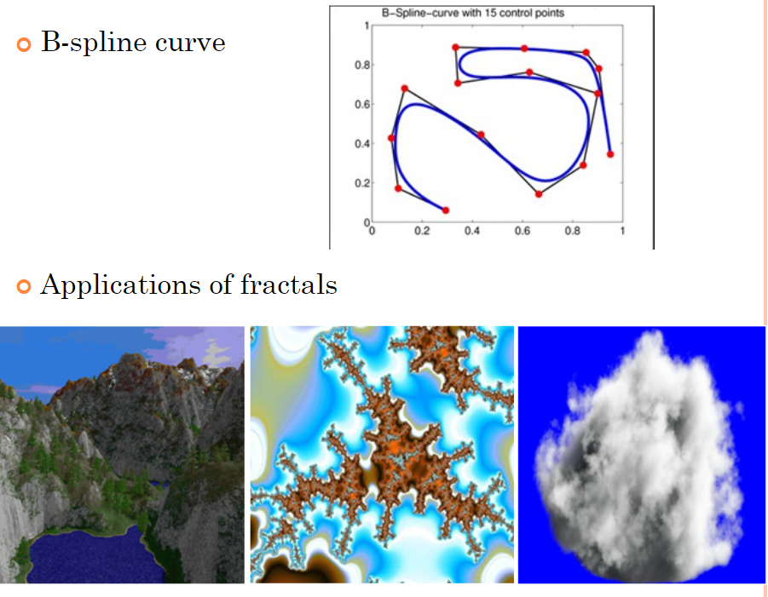

Slide 22
Color models
The RGB Color Model:
According to the tristimulus theory of vision, our eyes perceive color through the stimulation of three visual pigments in the cones of the retina. By comparing intensities in a light source, we perceive the color of the light.
This theory of vision is the basis for displaying color output on a video monitor using the three primaries red, green, and blue, which is referred to as the RGB color model.
We can represent this model using the unit cube defined on R, G, and B axes.

Slide 23
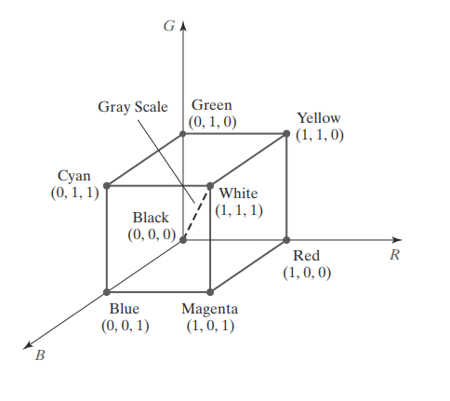

Slide 24
The origin represents black and the diagonally opposite vertex, with coordinates (1, 1, 1), is white. Vertices of the cube on the axes represent the primary colors, and the remaining vertices are the complementary color points for each of the primary colors.
As with the XYZ color system, the RGB color scheme is an additive model. Each color point within the unit cube can be represented as a weighted vector sum of the primary colors, using unit vectors R, G, and B:
C(λ) = (R, G, B) = R R + G G + B B

Slide 25
where parameters R, G, and B are assigned values in the range from 0 to 1.0. For example, the magenta vertex is obtained by adding maximum red and blue values to produce the triple (1, 0, 1), and white at (1, 1, 1) is the sum of the maximum values for red, green, and blue.
Shades of gray are represented along the main diagonal of the cube from the origin (black) to the white vertex. Points along this diagonal have equal contributions from each primary color, and a gray shade halfway between black and white is represented as (0.5, 0.5, 0.5).

Slide 26
The CMY and CMYK Color Models
A video monitor displays color patterns by combining light that is emitted from the screen phosphors, which is an additive process. However, hard-copy devices, such as printers and plotters, produce a color picture by coating a paper with color pigments. We see the color patterns on the paper by reflected light, which is a subtractive process.
The CMY Parameters:
A subtractive color model can be formed with the three primary colors cyan, magenta, and yellow. As we have noted, cyan can be described as a combination of green and blue. Therefore, when white light is reflected from cyancolored ink, the reflected light contains only the green and blue components, and the red component is absorbed, or subtracted, by the ink. Similarly, magenta ink subtracts the green component from incident light, and yellow subtracts the blue component. A unit cube representation for the CMY model is illustrated in Figure.

Slide 27
In the CMY model, the spatial position (1, 1, 1) represents black, because all components of the incident light are subtracted. The origin represents white light. Equal amounts of each of the primary colors produce shades of gray along the main diagonal of the cube. A combination of cyan and magenta ink produces blue light, because the red and green components of the incident light are absorbed. Similarly, a combination of cyan and yellow ink produces green light, and a combination of magenta and yellow ink yields red light.

Slide 28
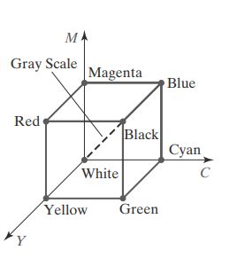

Slide 29
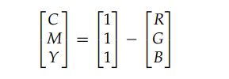
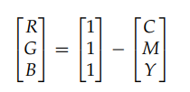
Transformations Between CMY and RGB Color Spaces :
We can express the conversion from an RGB representation to a CMY representation using the following matrix transformation.
where the white point in RGB space is represented as the unit column vector. And we convert from a CMY color representation to an RGB representation using the matrix transformation. In this transformation, the unit column vector represents the black point in the CMY color space.

Slide 30
Color Selection and Applications
A graphics package can provide color capabilities in a way that aids us in making color selections. For example, an interface can contain sliders and color wheels instead of requiring that all color specifications be provided as numerical values for the RGB components. In addition, some aids can be provided for choosing harmonious color combinations and for basic color selection guidelines.
One method for obtaining a set of coordinating colors is to generate the color combinations from a small subspace of a color model.
As a general rule, the use of a smaller number of colors produces a better looking display than one with a large number of colors. Also, tints and shades tend to blend better than the pure hues. For a background, gray or the complement of one of the foreground colors is usually best.

